Slide 1
SQL-more advanced
Outer joins
Aggregates
String operations and programming functions built in
1

Slide 2
Outerjoins
R OUTER JOIN S is the core of an outerjoin expression. It is modified by:
  Optional NATURAL in front of OUTER.
  Optional ON <condition> after JOIN.
  Optional LEFT, RIGHT, or FULL before OUTER.
    LEFT = pad dangling tuples of R only.
    RIGHT = pad dangling tuples of S only.
    FULL = pad both; this choice is the default.
Only one
of these

Slide 3
Left join (w3c tutorial)
The LEFT JOIN keyword returns all records from the left table (table1), and the matched records from the right table (table2). The result is NULL from the right side, if there is no match.

Slide 4
Drinkers who don’t like any beer
select d.name from drinkers d
where NOT EXISTS (select * from likes l where l.drinker = d.name)

Slide 5
Drinkers who do not like any beer
select d.name from drinkers d LEFT JOIN likes l on l.drinker=d.name
where l.drinker IS NULL

Slide 6
Bars frequented by drinkers who like no beers
select f.drinker, f.bar from likes l right join frequents f on l.drinker=f.drinker
where l.drinker IS NULL

Slide 7
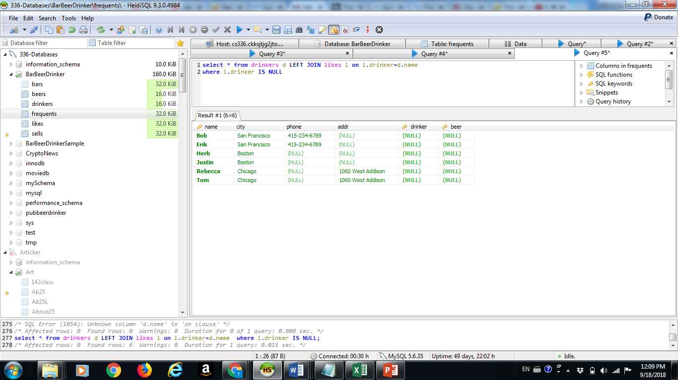
How left outer join works

Slide 8
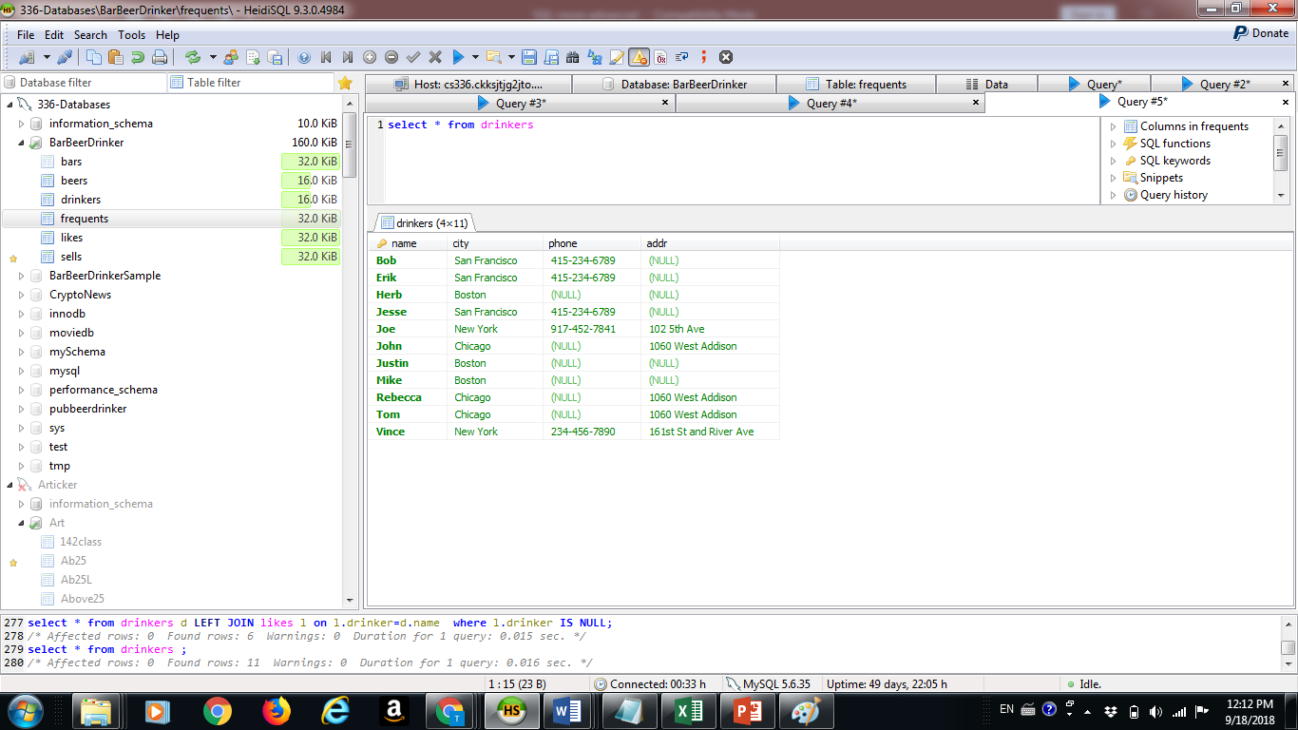
Drinkers table

Slide 9
Aggregations
SUM, AVG, COUNT, MIN, and MAX can be applied to a column in a SELECT clause to produce that aggregation on the column.
Also, COUNT(*) counts the number of tuples.

Slide 10
Example: Aggregation
From Sells(bar, beer, price), find the average price of Bud:
SELECT AVG(price)
FROM Sells
WHERE beer = ’Bud’;

Slide 11
Eliminating Duplicates in an Aggregation
Use DISTINCT inside an aggregation.
Example: find the number of different prices charged for Bud:
SELECT COUNT(DISTINCT price)
FROM Sells
WHERE beer = ’Bud’;

Slide 12
Grouping
We may follow a SELECT-FROM-WHERE expression by GROUP BY and a list of attributes.
The relation that results from the SELECT-FROM-WHERE is grouped according to the values of all those attributes, and any aggregation is applied only within each group.

Slide 13
Example: Grouping
From Sells(bar, beer, price), find the average price for each beer:
SELECT beer, AVG(price)
FROM Sells
GROUP BY beer;
beer AVG(price)
Bud 2.33
… …

Slide 14
Restriction on SELECT Lists With Aggregation
If any aggregation is used, then each element of the SELECT list must be either:
  Aggregated, or
  An attribute on the GROUP BY list.

Slide 15
Illegal Query Example
You might think you could find the bar that sells Bud the cheapest by:
SELECT bar, MIN(price)
FROM Sells
WHERE beer = ’Bud’;
But this query is illegal in SQL.

Slide 16
HAVING Clauses
HAVING <condition> may follow a GROUP BY clause.
If so, the condition applies to each group, and groups not satisfying the condition are eliminated.

Slide 17
Query with “having”
select bar, avg(price) as avgprice from sells
group by bar
having avgprice >3
order by avgprice desc

Slide 18
Some string processing functions and..
Extract substrings
Conditionals and programming statements

Slide 19
SUBSTR()
MySQL SUBSTR() returns the specified number of characters from a particular position of a given string. SUBSTR() is a synonym forSUBSTRING(). A string from which a substring is to be returned. ... An integer indicating a number of characters to be returned.

Slide 20
Example
Extract a substring from a string (start at position 5, extract 3 characters):
SELECT SUBSTR("SQL Tutorial", 5, 3) AS ExtractString;

Slide 21
SUBSTRING_INDEX
The SUBSTRING_INDEX() function returns the substring of string before number of occurrences of delimiter.
Syntax
SUBSTRING_INDEX(string, delimiter, number)

Slide 22
SELECT SUBSTRING_INDEX(phone, '-', 1) AS areacode from drinkers d;

Slide 23
If()
Return "YES" if the condition is TRUE, or "NO" if the condition is FALSE:
SELECT IF(price<5, “Cheap", “Expensive") as Category from sells ;

